Slide 1
The Election Process From a Data Prospective
By Kimball Brace, President
Election Data Services, Inc. 2017

Slide 2
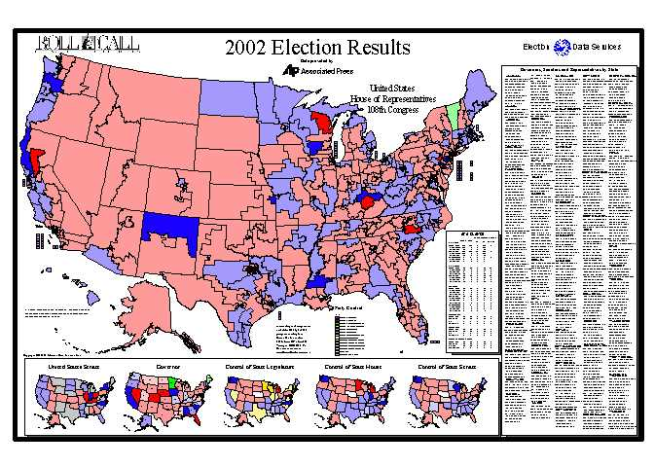
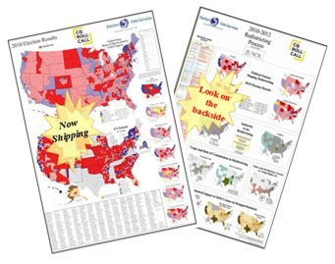
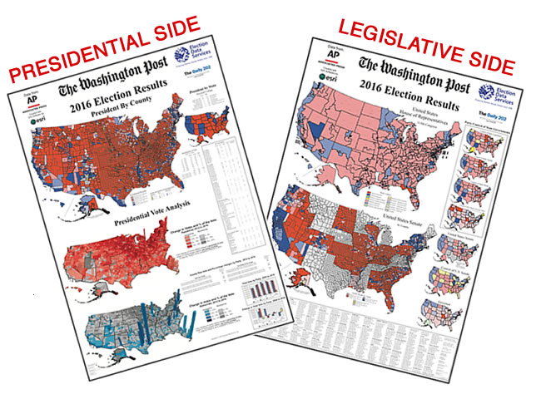
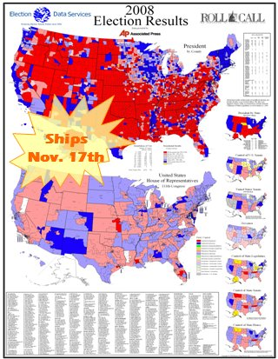
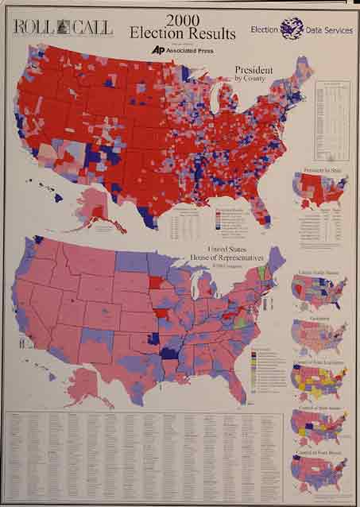
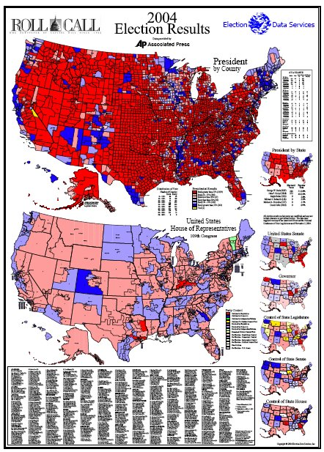
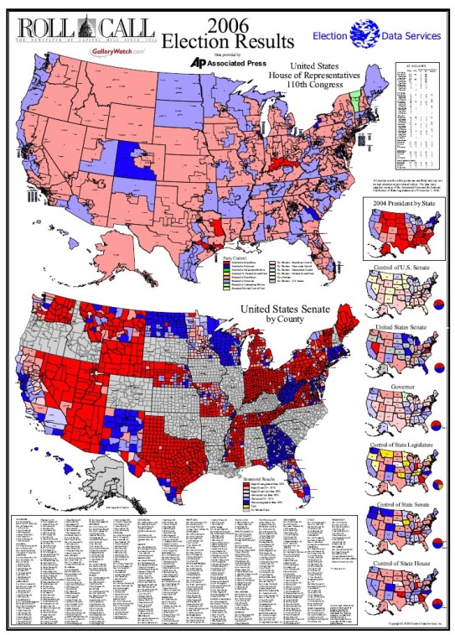
Who is Election Data Services, Inc.?
Since 1986, we’ve been on your wall.
Since 2010 you’ve needed a larger wall

Slide 3
Who is Election Data Services, Inc.?
Since 1979,
more than half the nation has been helped by
Election Data Services in redistricting
Compiled extensive databases of election results and census demographics for redistricting in more than half the nation over past 4 apportionments
Testified in more than 75 court cases.

Slide 4
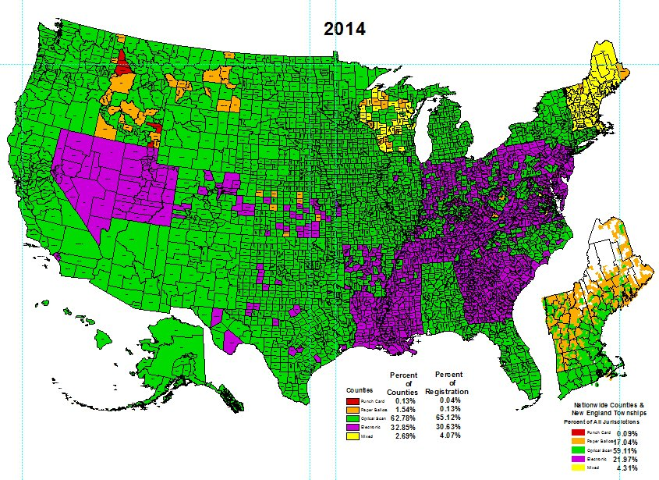
Who is Election Data Services, Inc.?
Since 1980, kept track of what voting equipment is used in every county of the nation for each election
2016

Slide 5
Who is Kim Brace?
That Old Guy Who’s been in Election Administration for 42 Years
Associate Editor of Dick Smolka’s
Election Administration Reports
Consultant to Federal, State & Local Governments
for Voting Equipment selection assistance
Undertaken multiple projects on election administration over decades
Worked with EAC on EAVS survey 2004 - 2008
Provider of PRECIS – GIS for Precinct maintenance & Street File Creation
Acting General Registrar for Prince William County, VA in 2013
Member of County’s Task Force on Long Lines
Currently Chairman of County’s Historical Commission
Poll Worker since 2008

Slide 6
Overview
Basic Election Administration Facts
Election Process from a Data Prospective
Registration Data
Turnout Data

Slide 7
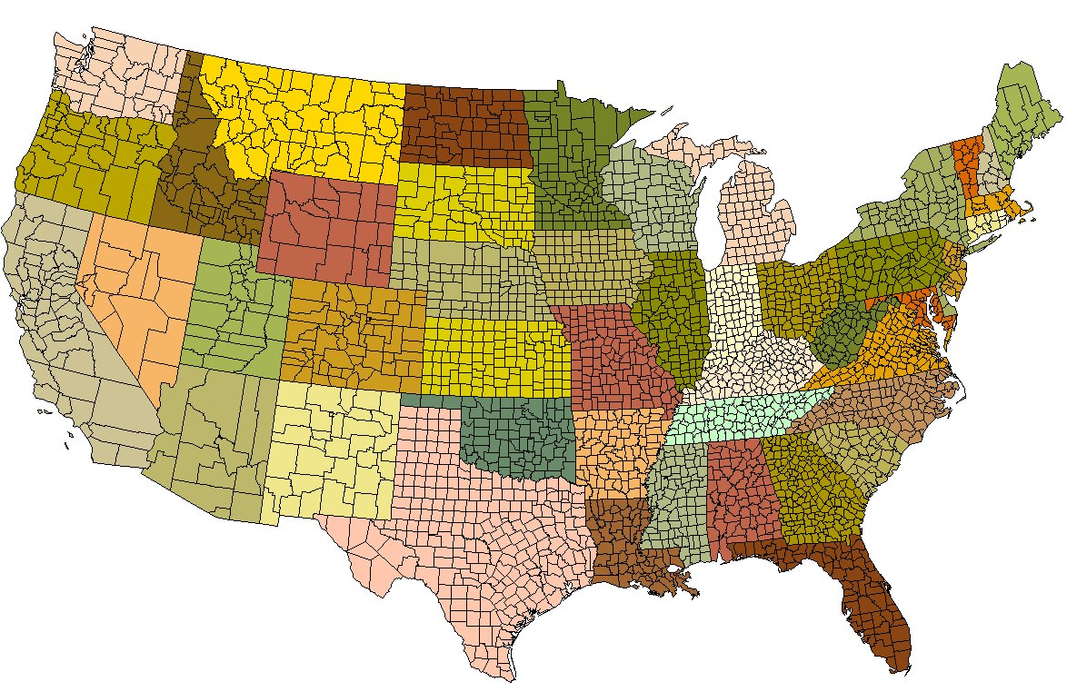
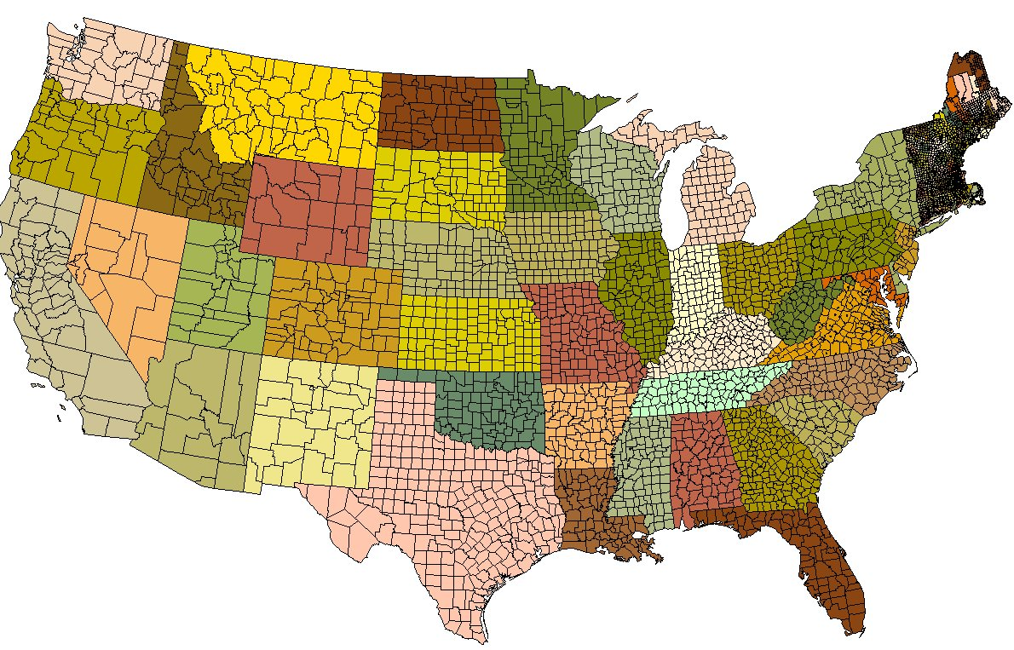
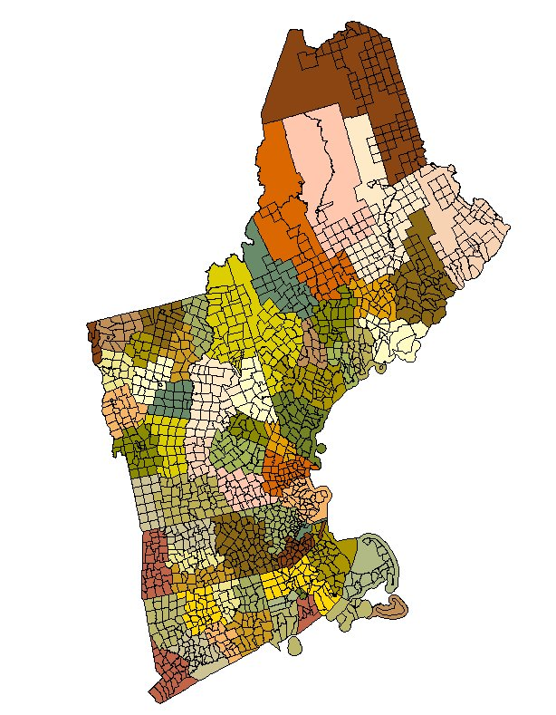
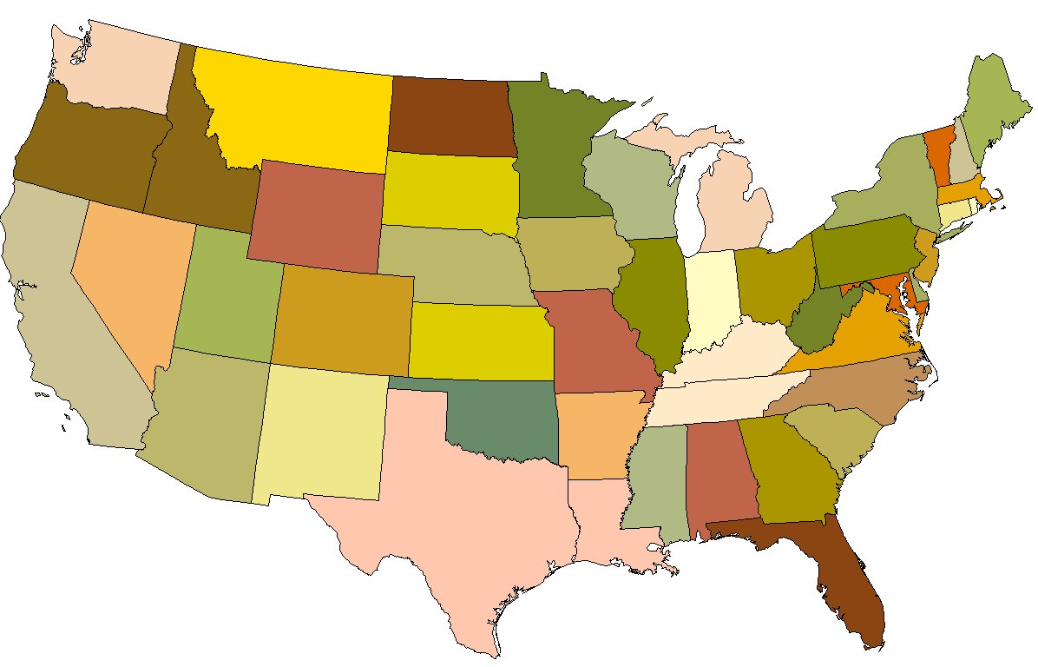
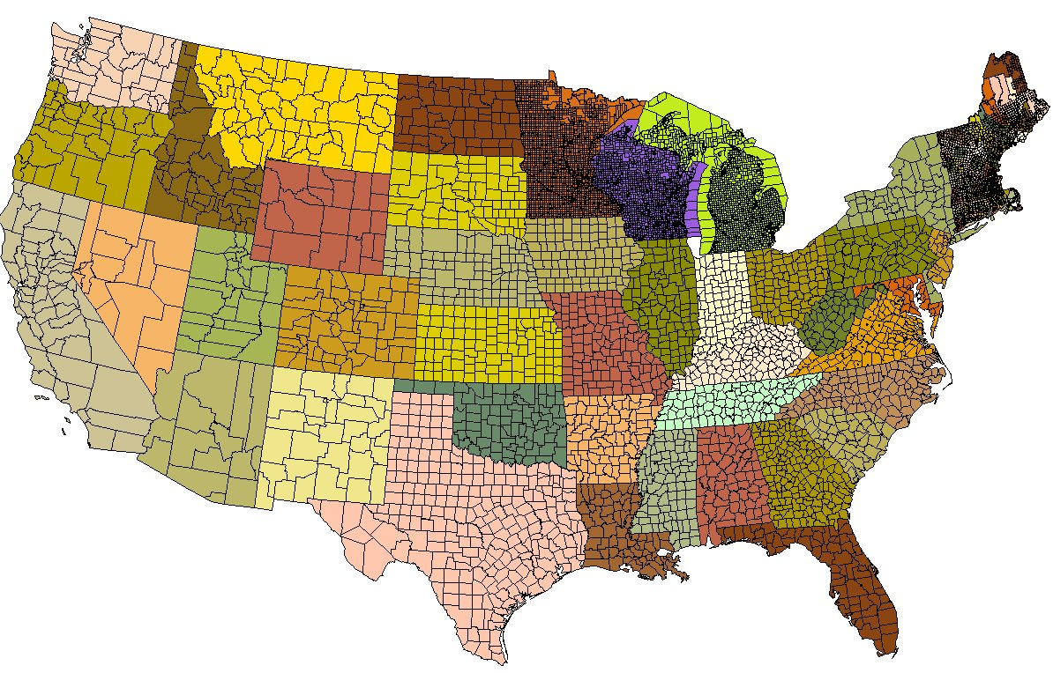
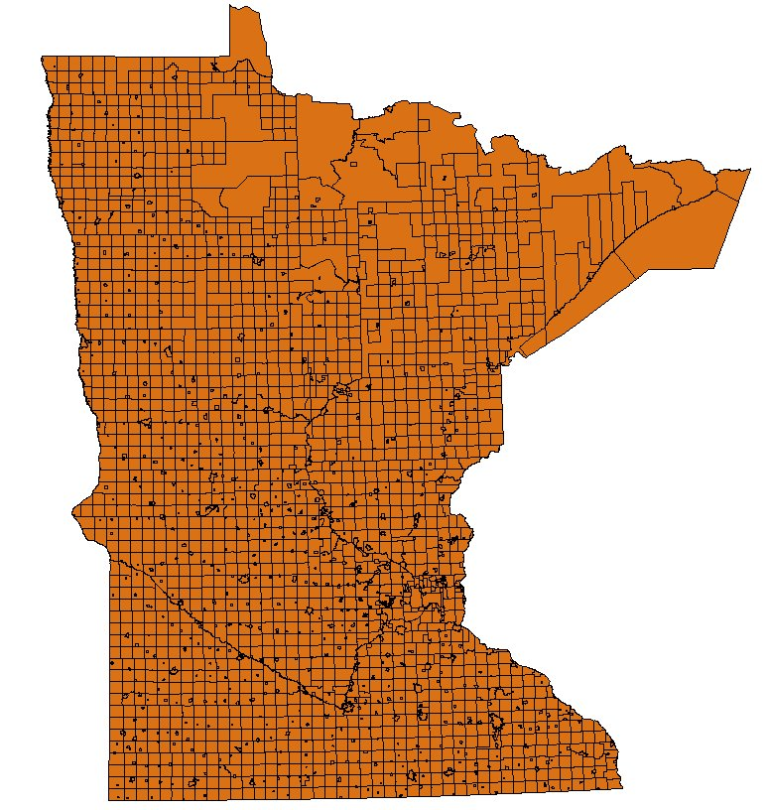
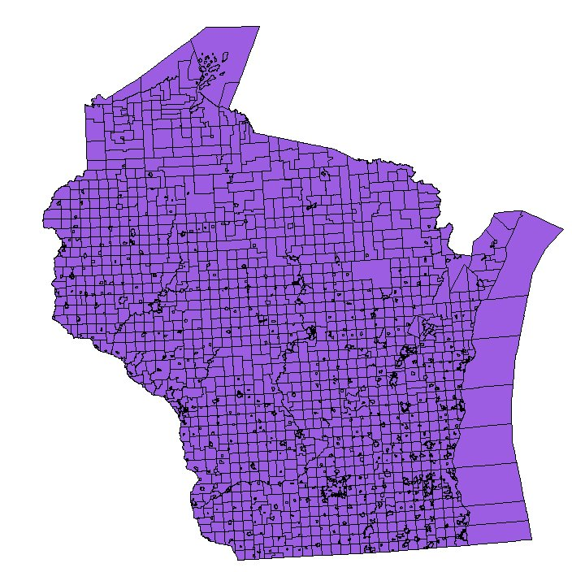
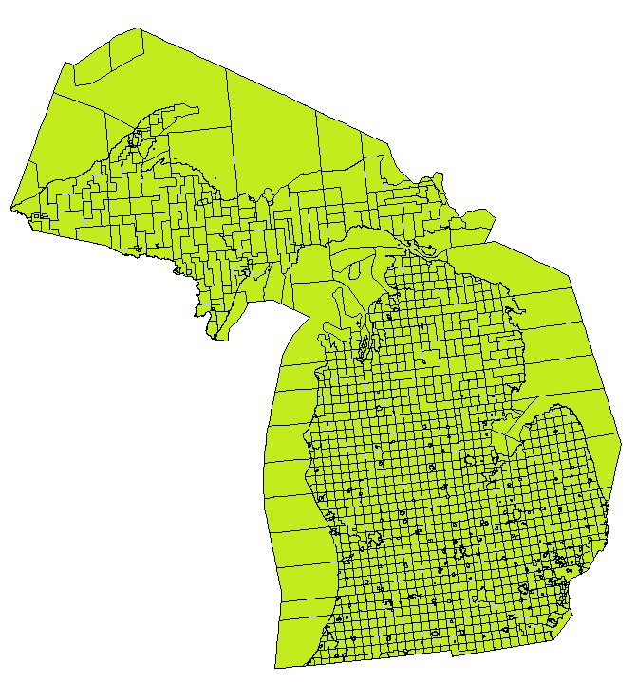
Basic Election Administration Facts
Diversity is the underpinning of Elections.
50 States
3,140 Counties
1,620 NE Townships
5,312 Midwest Townships
10,072 Election Jurisdictions

Slide 8
Basic Election Administration Facts
Size is important to remember
Question: What is the mean size of jurisdictions in the nation in terms of registration?
1,492 registered voters
Over 1/3rd of nations’ counties have fewer than 10,000 registered voters in them
Half of the nation’s counties have less than 16,000 registered voters
Only 343 jurisdictions have more than 100,000 registered voters
Only 14 counties have more than 1 million voters
Smallest County: Loving County, Texas: 136 voters
Largest County: Los Angeles, CA: 3.9 million voters
Take 930 smallest counties to reach LA’s total.

Slide 9
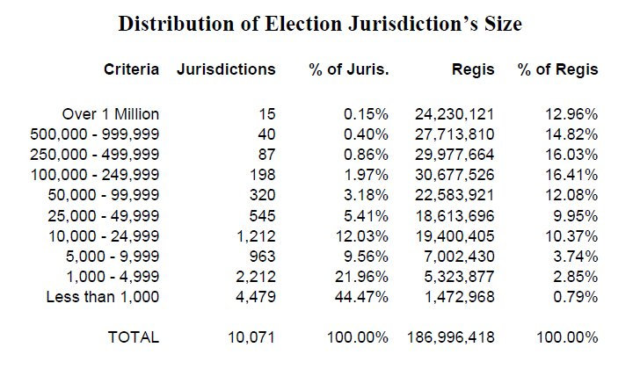
Basic Election Administration Facts

Slide 10
Basic Election Administration Facts
Elections are run in small jurisdictions
With small staff
Many of which are part-time or performing other functions
Reliance upon vendors for help

Slide 11
The Election Process – From a data element prospective
Total Population
Voting Age Population
Citizen Voting Age Population
Registration
Turnout
Votes for President
Other Statewide Offices
Congressional
Demographic Mix of Electorate
Changes with each Step
Changes by Different Geography
Changes Over Time
State
Legislature

Slide 12
Voter Registration
Election Data Services has collected county level registration counts since 1980, state level back to 1948
Our data formed the bases for Congressional Research Services studies on Voter Registration and Turnout rates across the nation.
Author: Royce Crocker, CRS Government Division
2004 Contract with Election Assistance Commission (EAC) to compile their Election Administration Survey (EAVS) found:
Not all states report registration the same way
25 states & DC: “Active” voters only
20 states: Combine “Active” & “In-actives”
3 states (IA, NJ, OH): Different determination in each county
2 states (ND, WI) used voting age population

Slide 13
2004

Slide 14
2006
*
*
*
*
*
*
*
*
*
*
*No Inactive
Registration Reported

Slide 15
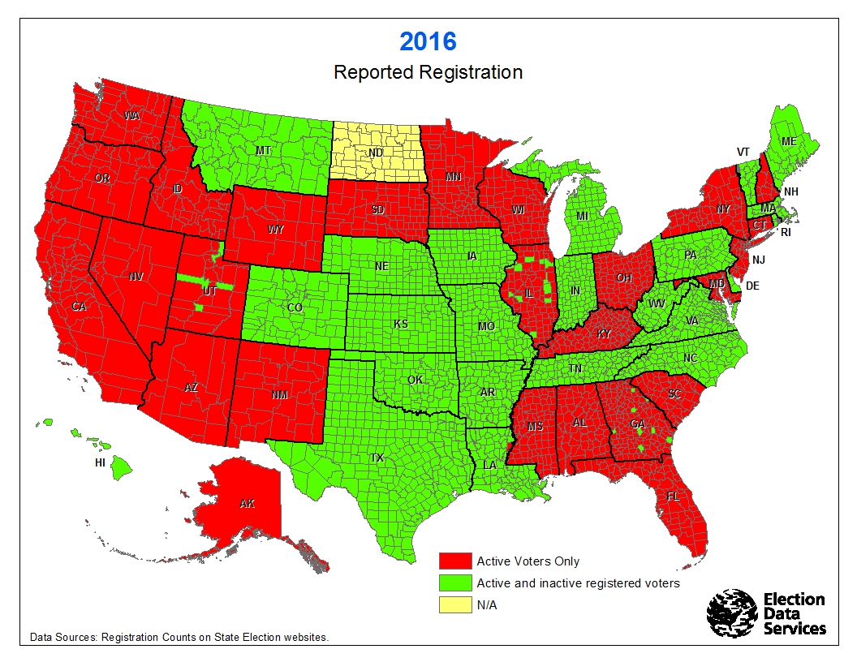
Registration
23 Active Only
23 Active & Inactive
3 Local Decision
1 Voting Age Population

Slide 16
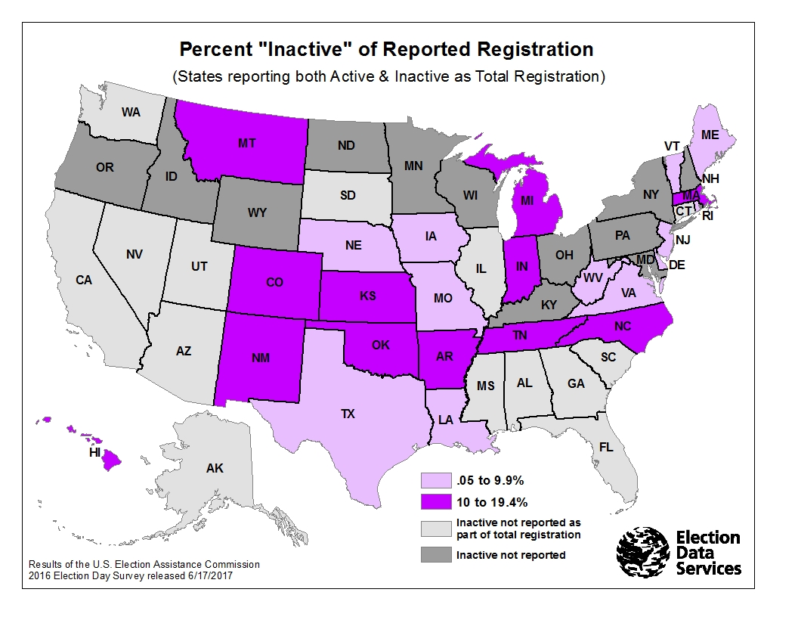
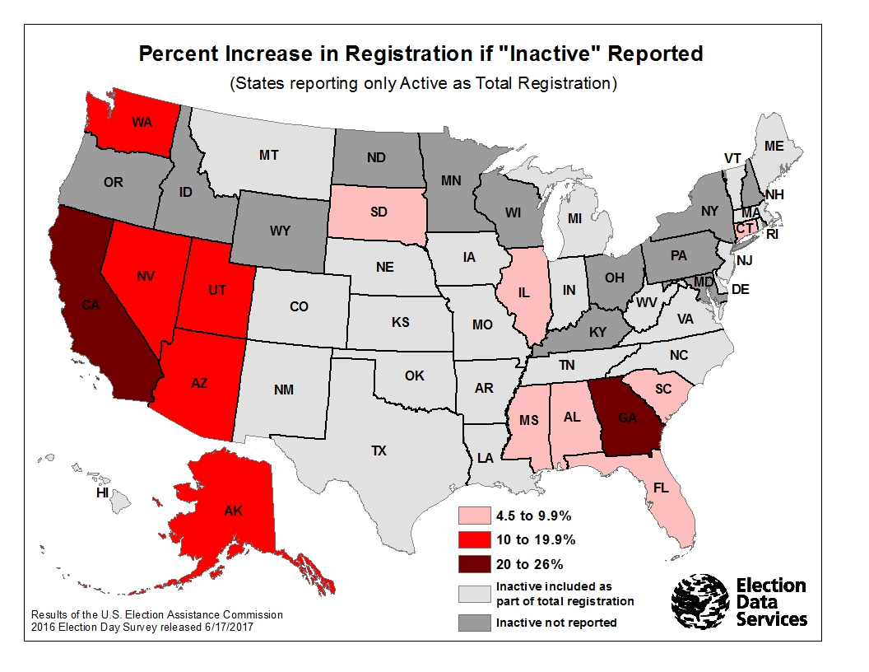
Impact of “In-actives” on registration file size 2016

Slide 17
In-active is fail-safe
In-active voters can still show up & vote
How many do?
Most jurisdictions don’t know. Not studied
Our research in Prince William County showed:
11% of In-active voters showed up & voted
Call upon all Election Administrators to determine what percent of In-active voters showed up & voted in their jurisdictions

Slide 18
Simple concept:
Compare
Voting Age Population
To
Registered Voters
Instinctively you shouldn’t have
more registered voters than you have voting age population

Slide 19
Registration of Voting Age Population

Slide 20
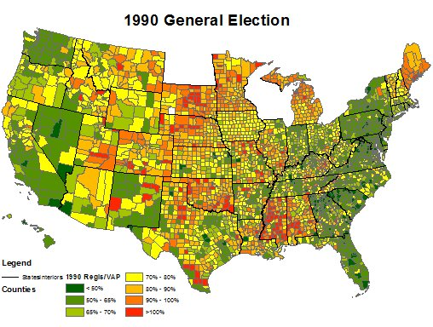

Slide 21
Voting Age Population:
Date of VAP
Census conducted every 10 years
Done in April of years ending in “0”
Because elections are conducted in November,
one has to “age” the data by 7 months
American Community Survey (ACS) conducted every year, but to get county level data you need to have five years of surveys to create a number, especially for small counties.
Survey’s are based on a “June” date
One has to “age” the data another 5 months
ACS data lags in release dates
2016 numbers just came out

Slide 22
Voting Age Population:
Accuracy of Census data
Even decennial census’s have an error:
an over count and an undercount
But those error rates are announced as nationwide numbers, not by state and certainly not by county
ACS (because it is a “survey”, not a 100% census) has what’s called “Margins of Error” or MOEs.
These are generated for all levels of geography (like counties), but the smaller the populations, the larger the MOE. Therefore MOEs really affect smaller counties to a greater degree than larger counties.

Slide 23
Voting Age Population:
Special Considerations in certain areas:
Some states allow 16 & 17 year-olds to register, but these are not in the VAP data from the Census Bureau
Large numbers of military & persons living overseas are not allocated to local jurisdictions by the Census Bureau, even though they can register to vote there.

Slide 24
Voting Age Population:
Citizenship
Not a question on the decennial census.
Only available from the ACS survey (with all those
flaws already noted)
Traditionally come out after election
2016 numbers finally just released

Slide 25
Registration:
Registration
Deadline for registration varies for November election
Reported registration carried on state’s websites varies on whether they include or exclude “inactive”.
This even varies by county in some states (as can be seen when comparing EAC results with state reported registration for election.
Know there are some jurisdictions that have more
“deadwood” in their registration rolls than others.

Slide 26
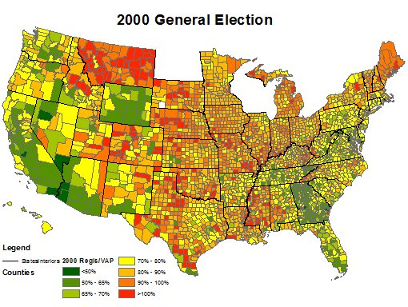

Slide 27
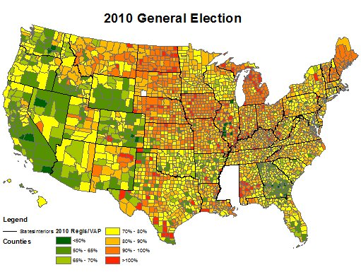

Slide 28
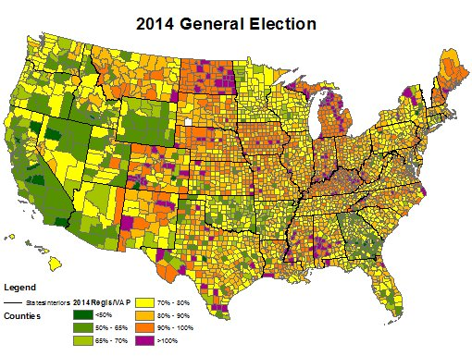

Slide 29
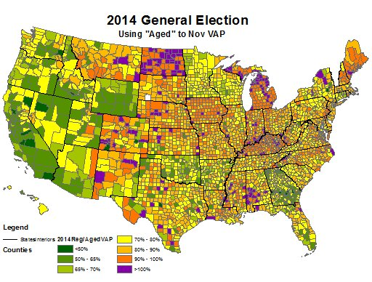

Slide 30
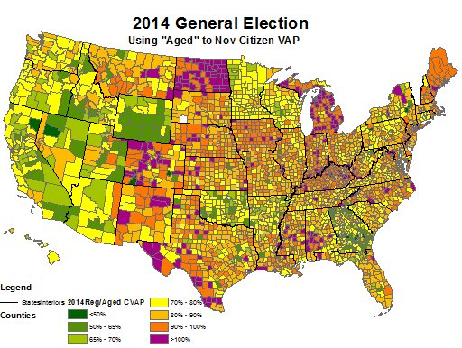

Slide 31
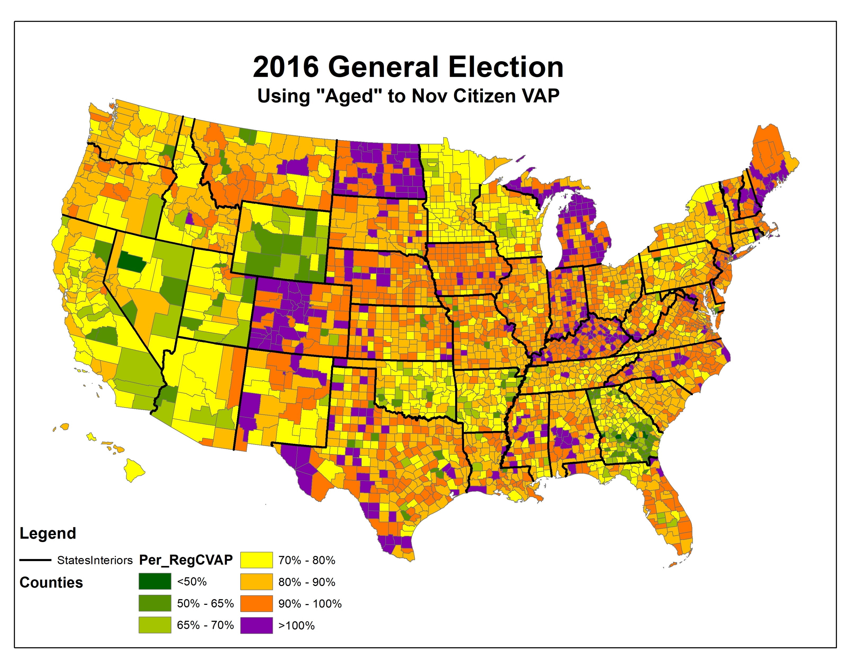

Slide 32
2016 Data
241 Counties with more than 100% of Voting Age Population that’s Registered.
351 Counties with more than 100% of Citizen Voting Age Population that’s Registered.
Highest percentage is 212% of VAP and 226% of CVAP
Harding County, New Mexico
Registration = 742, VAP = 592
Of the 241 Counties with Regis of VAP >100%
213 had fewer than 50,000 Regis voters
Trump Carried 193 of the Counties
Of the 351 Counties with Regis of CVAP >100%
269 had fewer than 50,000 Regis voters
Trump Carried 246 of the Counties

Slide 33
Registration
23 Active Only
23 Active & Inactive
3 Local Decision
1 Voting Age Population

Slide 34
Registration Summary
Many more Jurisdictions open to questions on their data because there is no uniformity in definitions.
However:
It is the smaller jurisdictions that are caught with the problem of small numbers
VAP or CVAP estimate of 1,300 compared to a registration of 1,360. Which is right?
Estimates Are Estimates

Slide 35
Turn-out
What is Turn-out?
Different states say different things make it up.

Slide 36
2004

Slide 37
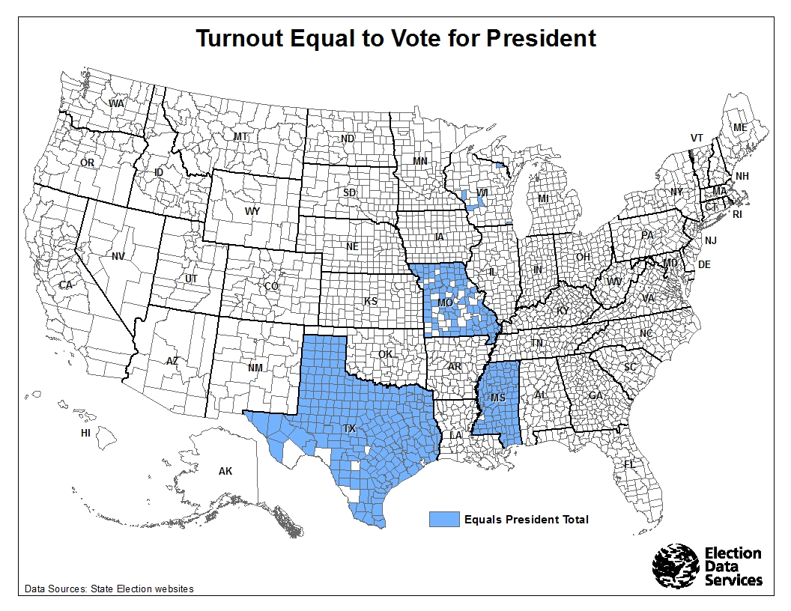
2016
2016

Slide 38
How many people participated in the 2012 General Election?
Obama 65,899,392
Romney 60,929,639
Others 2,211,840
TOTAL 129,040,871
But Presidential contest was not the highest vote generator in all counties
More votes cast for US Senate Contests in 99 Counties
Governor Contests in 48 Counties
US House Contests in 28 Counties

Slide 39
How many people participated in the 2016 General Election?
Clinton 65,840,578
Trump 62,978,288
Others 7,558,877
TOTAL 136,377,743
But Presidential contest was not the highest vote generator in all counties
More votes cast for US Senate Contests in 209 Counties
Governor Contests in 119 Counties
US House Contests in 73 Counties

Slide 40
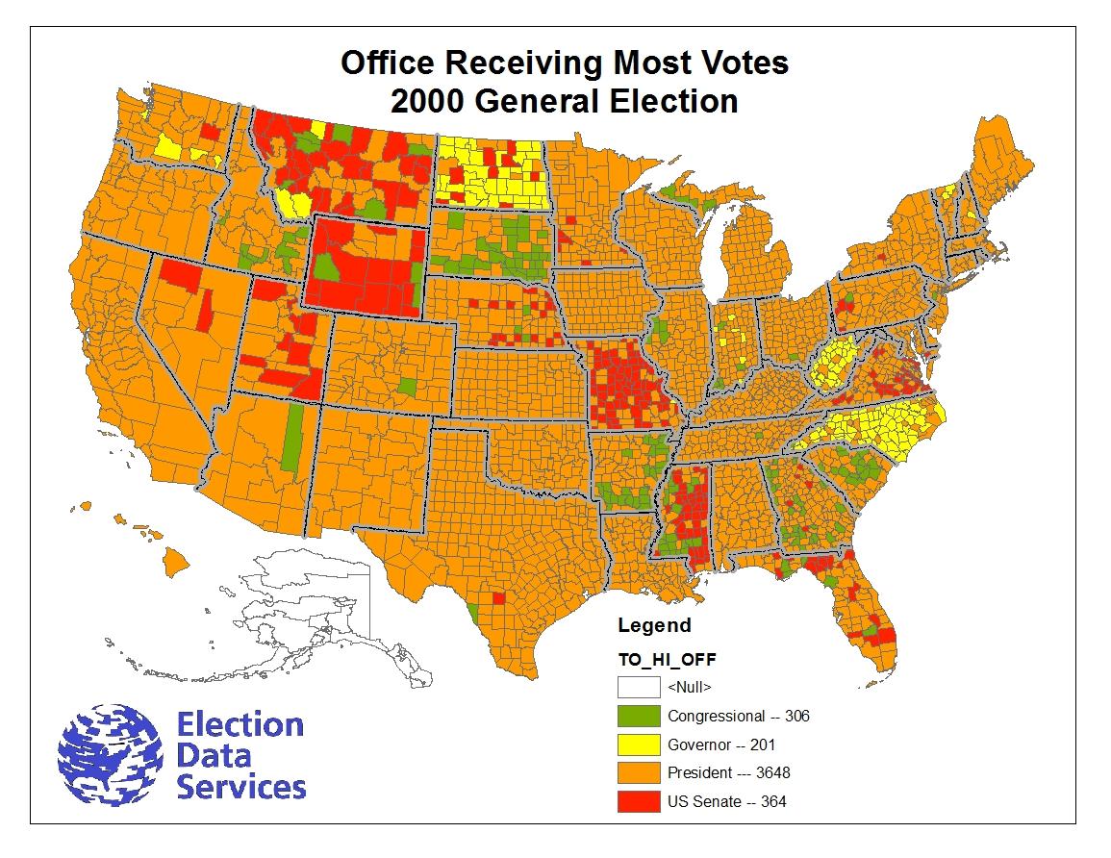

Slide 41
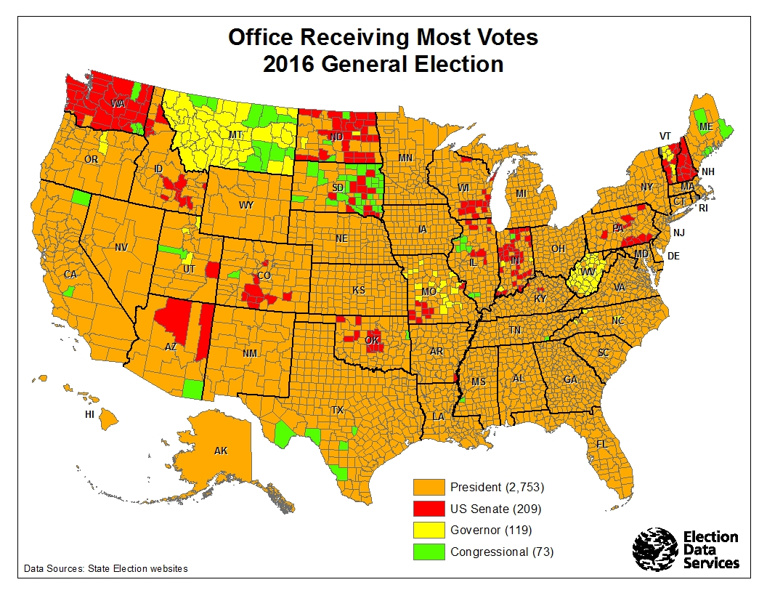

Slide 42
How many people participated in the 2012 General Election?
EAC survey reported that
129,664,614 persons participated
in 50 states
But their survey lacked data in the following:
1 County in California
24 Counties in Mississippi
7 Counties in New Mexico
1 Township in Vermont
EDS dataset shows at least 130,081,900 participated
Means that over 1.4 million participated, but didn’t cast a ballot for President – 0.8%

Slide 43
How many people participated in the 2016 General Election?
EAC survey reported that
138,467,690 persons participated
in 50 states and DC
(Excluding Puerto Rico, Virgin Islands & Guam)
But their survey lacked data in the following:
6 Counties in Arkansas
39 Counties in Texas
EDS dataset shows at least 138,773,658 participated
Means that around 2.4 million participated, but didn’t cast a ballot for President – 1.7%

Slide 44
Drop – off (or Residual Votes)
(Difference between Total Turn-out & Votes for highest office)

Slide 45
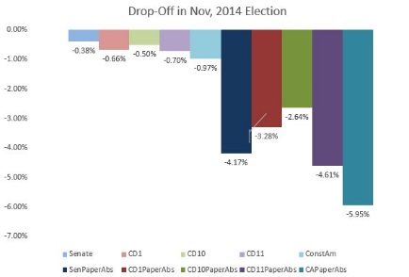
Prince William County, VA
DREs Absentee Paper Ballots

Slide 46
How many people participated in the 2016 General Election?
WE DON’T KNOW

Slide 47
Turn-out

Slide 48
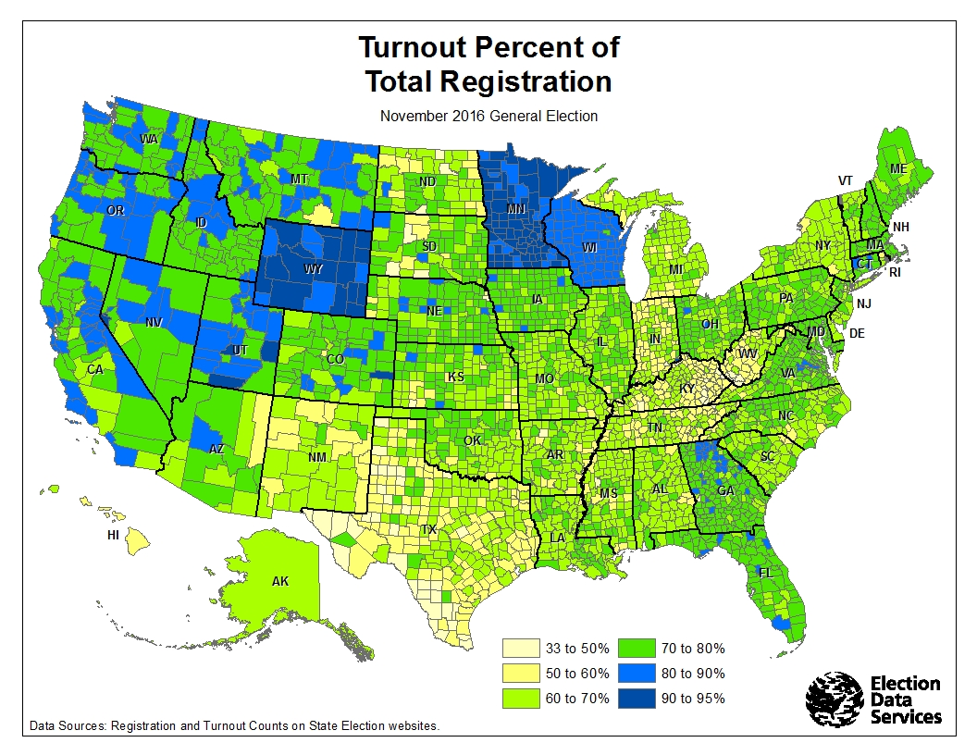

Slide 49
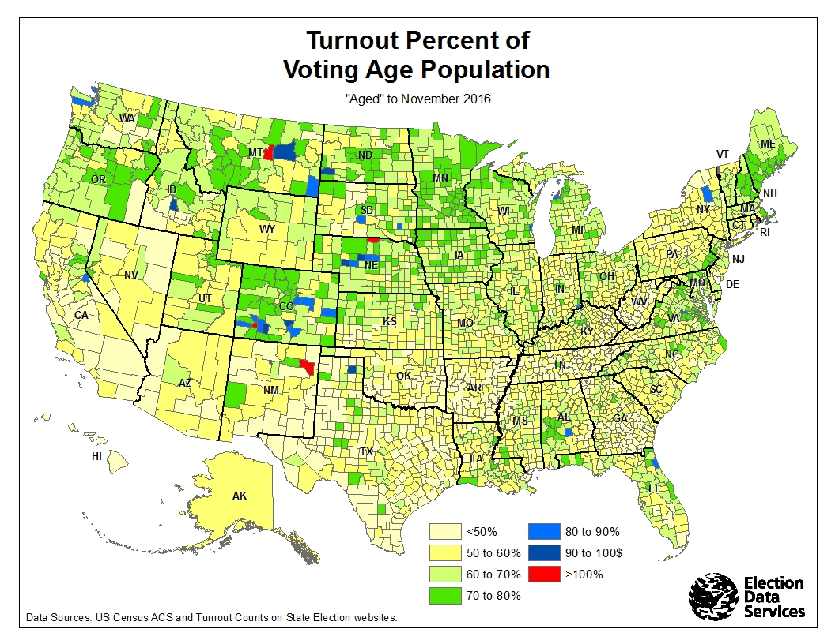
4 Counties
>100% TO of VAP
All had < 530 voters who turned out
Trump carried 3 of 4

Slide 50
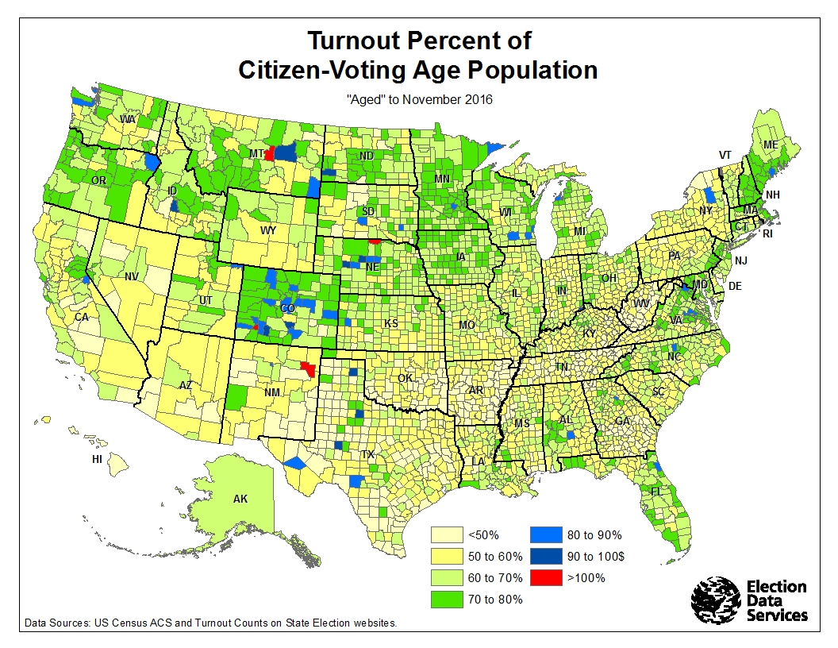
Same 4 Counties
>100% TO of CVAP

Slide 51
What Demographic Variable had Largest Range in Participating/Not Participating in Electoral Process?
Census Bureau’s bi-annual voting studies back to 1964
Whether people Registered or Voted
Age
Race
Income
Home Ownership
Do you own your home/shelter?
Or do you rent?
Are you invested in your community?

Slide 52
I Believe it’s important to study all data
To know their pluses & minuses
To be aware of its idiosyncrasies & nuances
To seek clarification when data doesn’t appear correct
To understand their relationships
To view their variation over geography & time
To be cognizance of people’s “spin” on the data.
Let the data tell the story
After all, data is our middle name

Slide 53
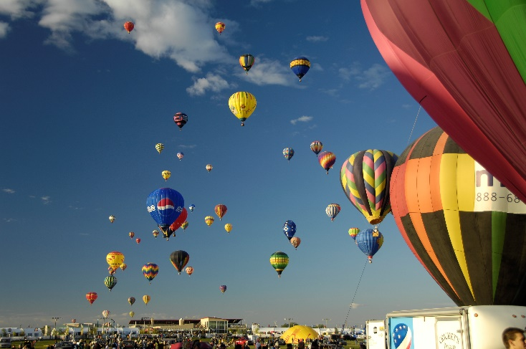
Thank you
Kimball Brace
President
Election Data Services, Inc.
6171 Emerywood Court
Manassas, VA 20112
(703-580-7267 or 202-789-2004)
KBrace@electiondataservices.com or KBrace@aol.com
www.electiondataservices.com

